Slide 1

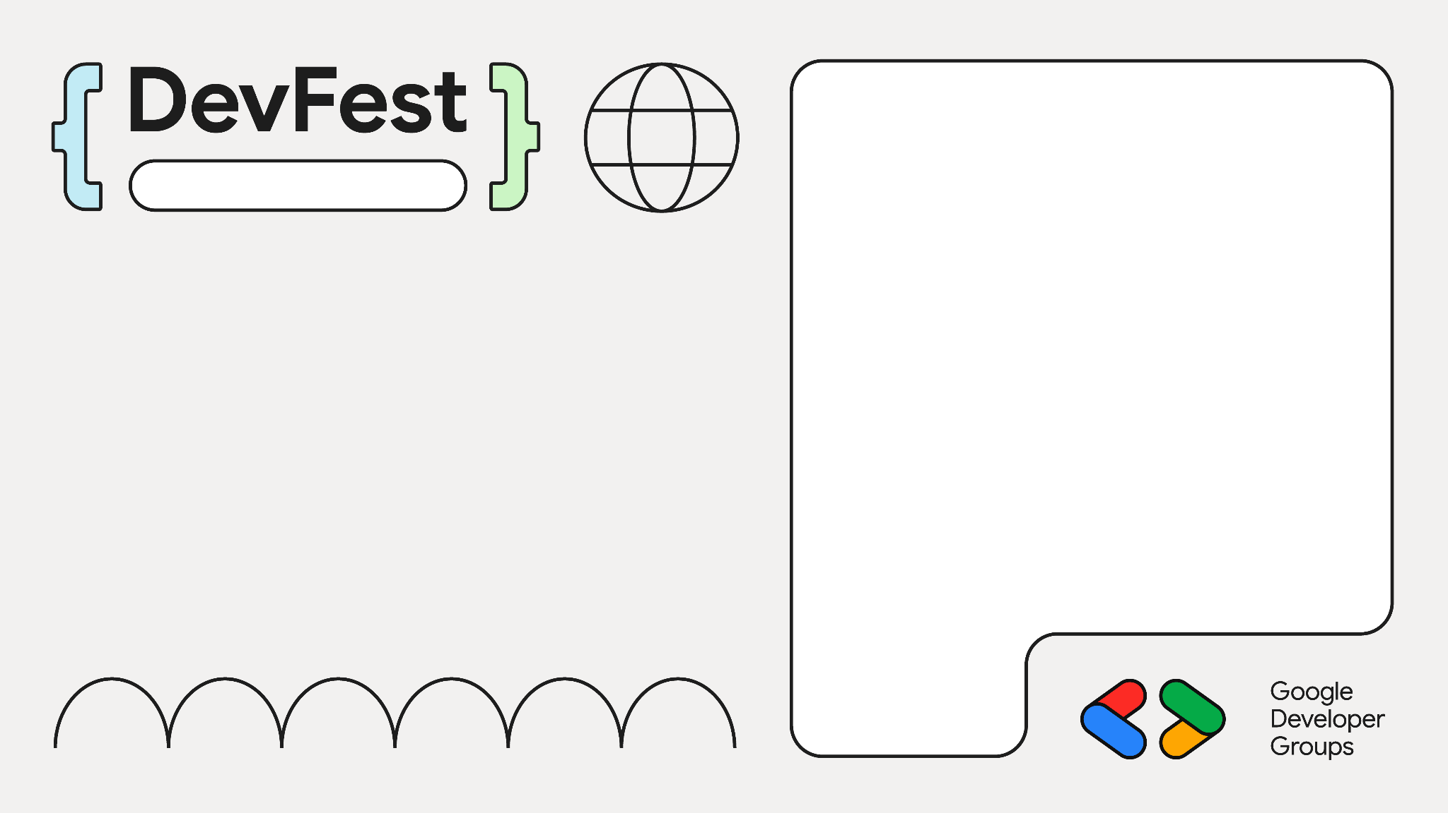

Compose 的魔法代码揭秘
Beijing
【这都怎么实现的?】
朱凯（@扔物线 ）

Slide 2

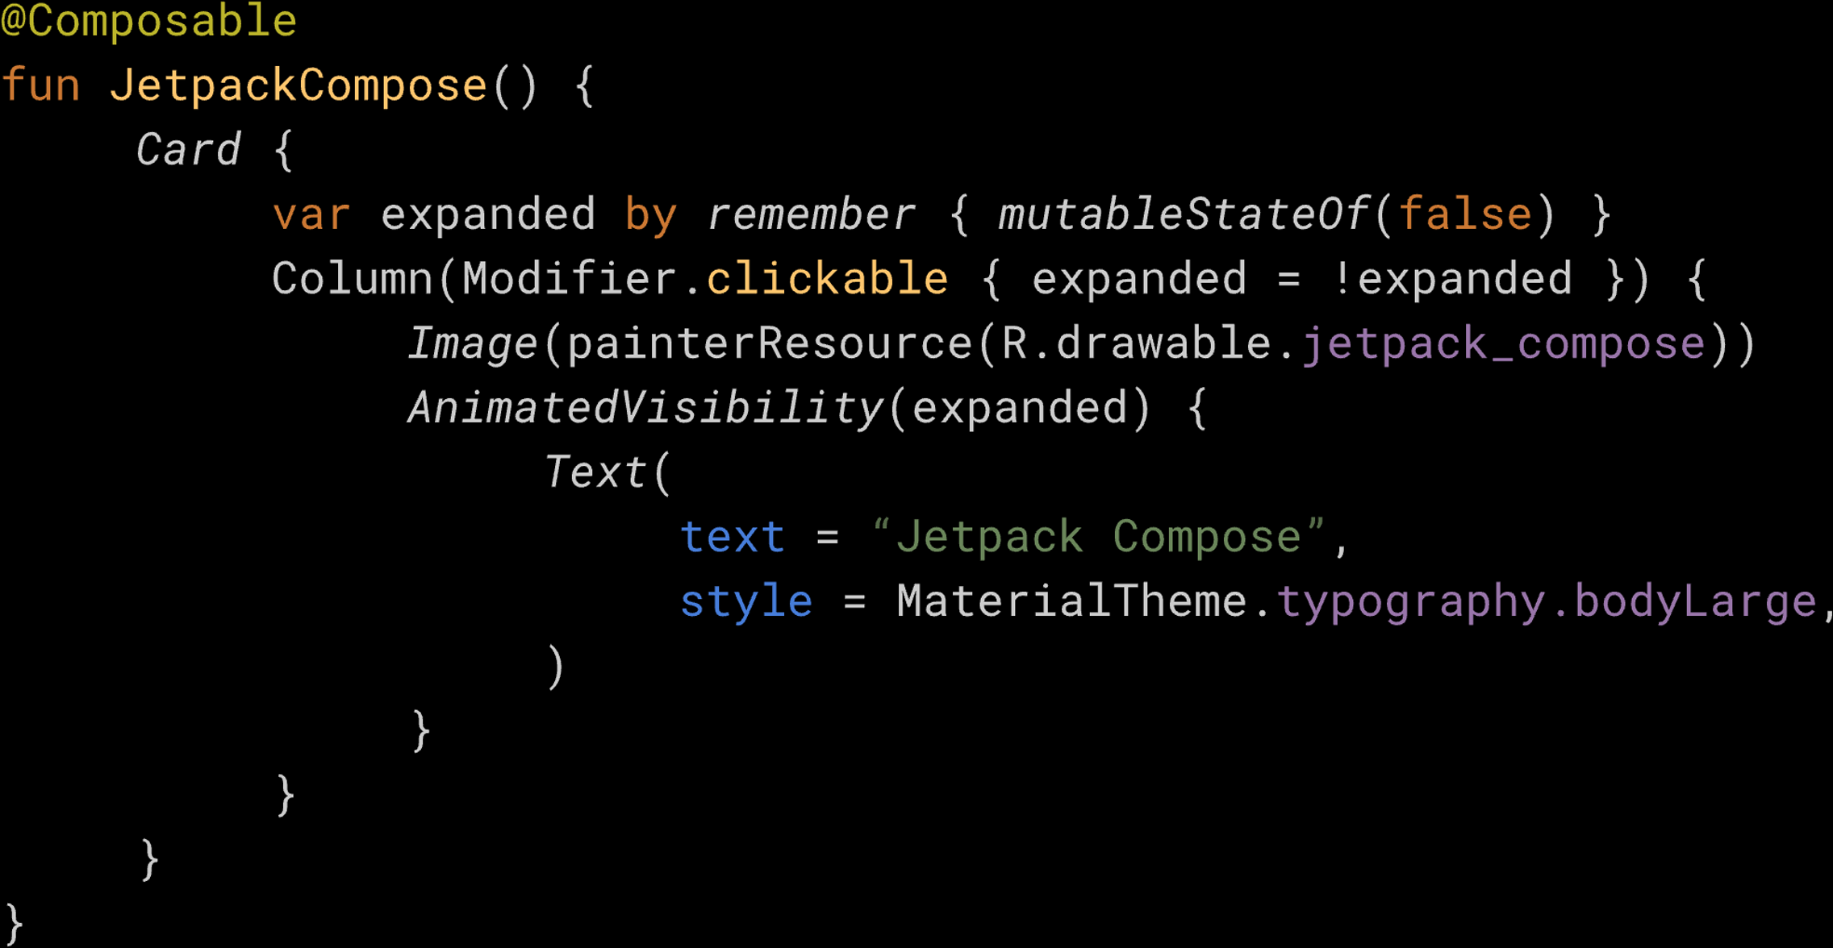

Slide 3
Implicit Receiver

Slide 4
class User {
private String name;
User(String name) { this.name = name; }
}
public String getName() { return this.name; }

Slide 5
public String getName() { return this.name; }

Slide 6
public String getName() { return name; }

Slide 7
public class OuterClass { int outerInt = 1; class InnerClass { int innerInt = 2; public void innerMethod() { System.out.println(outerInt); System.out.println(innerInt); } } }

Slide 8
public class OuterClass { int outerInt = 1; class InnerClass { int innerInt = 2; public void innerMethod() { System.out.println(outerInt); System.out.println(innerInt); } } }

Slide 9
public class OuterClass { int outerInt = 1; class InnerClass { int innerInt = 2; public void innerMethod() { System.out.println(outerInt); System.out.println(innerInt); } } }

Slide 10
public class OuterClass { int outerInt = 1;
class InnerClass { int innerInt = 2;
public void innerMethod() { System.out.println(outerInt); System.out.println(innerInt); } } }

Slide 11
public class OuterClass { int outerInt = 1;
int commonInt = 3; class InnerClass { int innerInt = 2;
int commonInt = 4; public void innerMethod() { System.out.println(outerInt); System.out.println(innerInt); System.out.println(commonInt); } } }

Slide 12
public class OuterClass { int outerInt = 1;
int commonInt = 3; class InnerClass { int innerInt = 2;
int commonInt = 4; public void innerMethod() { System.out.println(outerInt); System.out.println(innerInt); System.out.println(commonInt); } } }

Slide 13
public class OuterClass { int outerInt = 1;
int commonInt = 3; class InnerClass { int innerInt = 2;
int commonInt = 4; public void innerMethod() { System.out.println(outerInt); System.out.println(innerInt); System.out.println(commonInt); } } }

Slide 14
public class OuterClass { int outerInt = 1;
int commonInt = 3; class InnerClass { int innerInt = 2;
int commonInt = 4; public void innerMethod() { System.out.println(outerInt); System.out.println(innerInt); System.out.println(OuterClass.this.commonInt); } } }

Slide 15
public class OuterClass { int outerInt = 1;
int commonInt = 3; class InnerClass { int innerInt = 2;
int commonInt = 4; public void innerMethod() { System.out.println(outerInt); System.out.println(innerInt); System.out.println(OuterClass.this.commonInt); } } }

Slide 16
public class OuterClass { int outerInt = 1;
int commonInt = 3; class InnerClass { int innerInt = 2;
int commonInt = 4; public void innerMethod() { System.out.println(outerInt); System.out.println(innerInt); System.out.println(OuterClass.this.commonInt); } } }

Slide 17
class IntMultiplier(var time: Int = 2) { fun multiply(num: Int) = num * time }

Slide 18
class IntMultiplier(var time: Int = 2) { fun multiply(num: Int) = num * time }
val multiplier = IntMultiplier(3)

Slide 19
class IntMultiplier(var time: Int = 2) { fun multiply(num: Int) = num * time }
val multiplier = IntMultiplier(3) println(multiplier.multiply(2)) // 6

Slide 20
class IntMultiplier(var time: Int = 2) { fun multiply( Int) = num * time }
val multiplier = IntMultiplier(3) println(multiplier.multiply(2)) // 6

Slide 21
class IntMultiplier(var time: Int = 2) { fun Int.multiply() = num * time }
val multiplier = IntMultiplier(3) println(multiplier.multiply(2)) // 6

Slide 22
class IntMultiplier(var time: Int = 2) { fun Int.multiply() = this * time }
val multiplier = IntMultiplier(3) println(multiplier.multiply(2)) // 6

Slide 23
class IntMultiplier(var time: Int = 2) { fun Int.multiply() = this * time }
val multiplier = IntMultiplier(3) println(multiplier.multiply(2)) // 6

Slide 24
class IntMultiplier(var time: Int = 2) { fun Int.multiply() = this * time }
val multiplier = IntMultiplier(3) println( multiply(2)) // 6

Slide 25
class IntMultiplier(var time: Int = 2) { fun Int.multiply() = this * time }
val multiplier = IntMultiplier(3) println( 2.multiply()) // 6

Slide 26
class IntMultiplier(var time: Int = 2) { fun Int.multiply() = this * time }
val multiplier = IntMultiplier(3) println(2.multiply())

Slide 27
class IntMultiplier(var time: Int = 2) { fun Int.multiply() = this * time }
val multiplier = IntMultiplier(3) println(2.multiply())

Slide 28
class IntMultiplier(var time: Int = 2) { fun Int.multiply() = this * time
}
val multiplier = IntMultiplier(3) println(2.multiply())

Slide 29
class IntMultiplier(var time: Int = 2) { fun Int.multiply() = this * time
fun asOuter(block: IntMultiplier.() -> Unit) { block() } }
val multiplier = IntMultiplier(3) println(2.multiply())

Slide 30
class IntMultiplier(var time: Int = 2) { fun Int.multiply() = this * time
fun asOuter(block: IntMultiplier.() -> Unit) { block() } }
val multiplier = IntMultiplier(3)
println(2.multiply())

Slide 31
class IntMultiplier(var time: Int = 2) { fun Int.multiply() = this * time
fun asOuter(block: IntMultiplier.() -> Unit) { block() } }
val multiplier = IntMultiplier(3)
multiplier.asOuter { println(2.multiply()) }

Slide 32
class IntMultiplier(var time: Int = 2) { fun Int.multiply() = this * time
fun asOuter(block: IntMultiplier.() -> Unit) { block() } }
val multiplier = IntMultiplier(3)
multiplier.asOuter { println(2.multiply()) }

Slide 33
class IntMultiplier(var time: Int = 2) { fun Int.multiply() = this * time
fun asOuter(block: IntMultiplier.() -> Unit) { block() } }
val multiplier = IntMultiplier(3)
multiplier.apply { println(2.multiply()) }

Slide 34
class IntMultiplier(var time: Int = 2) { fun Int.multiply() = this * time
fun asOuter(block: IntMultiplier.() -> Unit) { block() } }
val multiplier = IntMultiplier(3)
with(multiplier) { println(2.multiply()) }

Slide 35
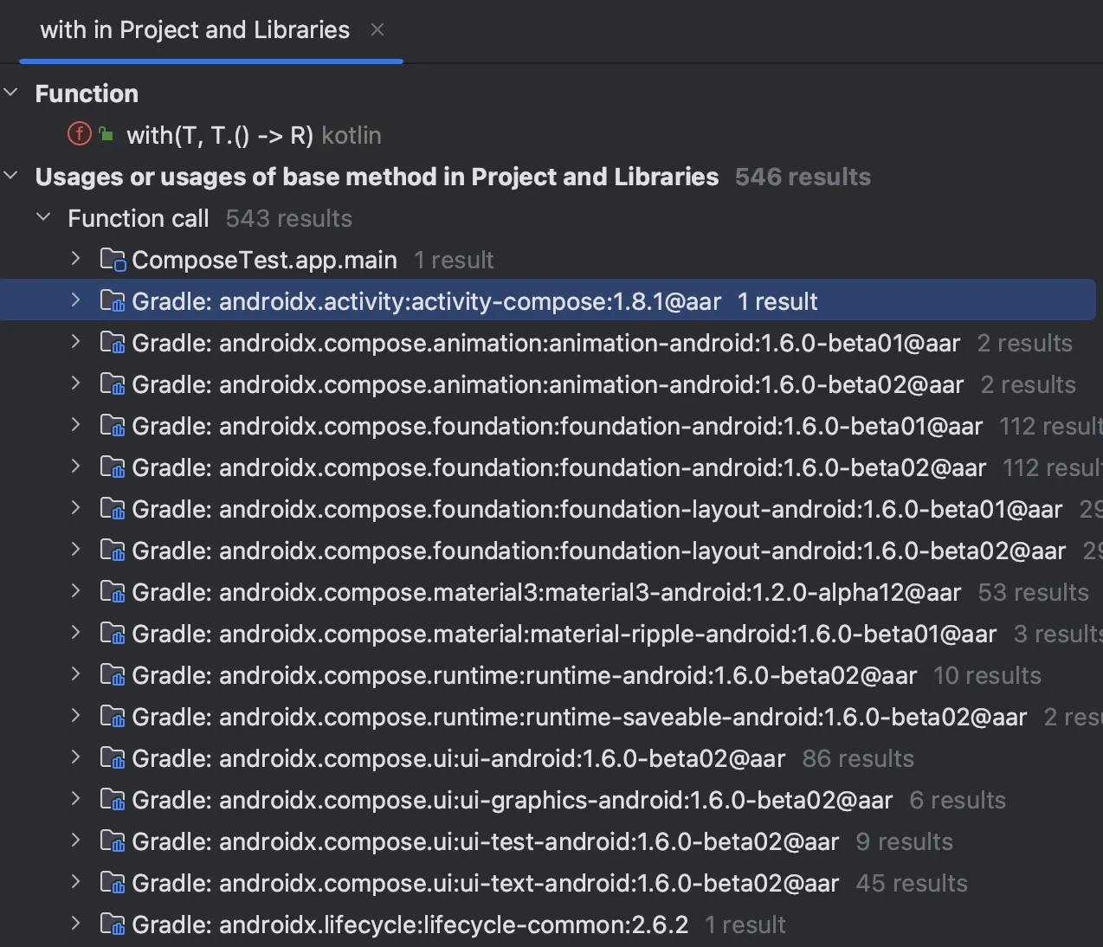

Slide 36
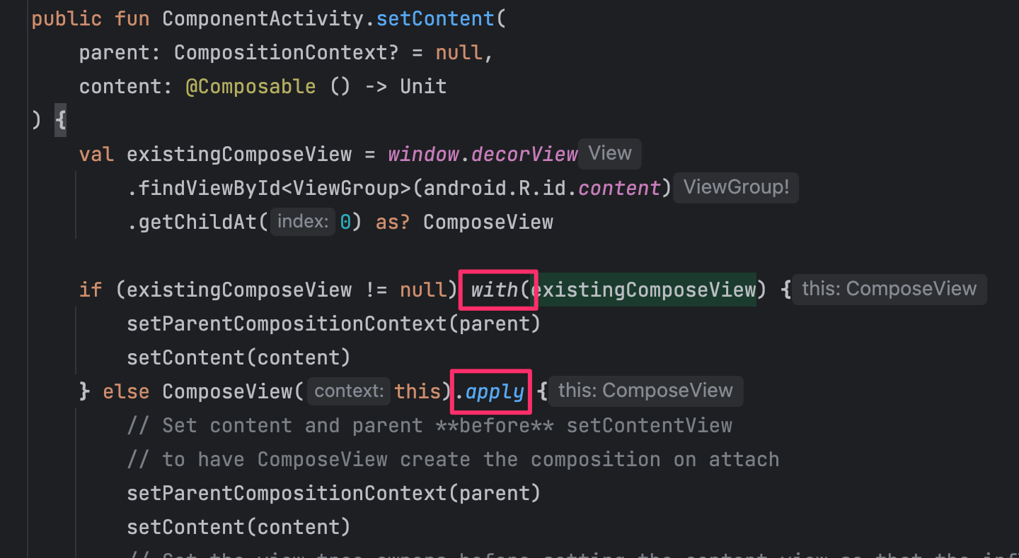

Slide 37
Row { Text("Hello", Modifier.align(Alignment.CenterVertically)) }

Slide 38
Modifier.align(Alignment.CenterVertically)
Row { Text("Hello", Modifier.align(Alignment.CenterVertically)) }

Slide 39
Modifier.align(Alignment.CenterVertically)
Row { Text("Hello", Modifier.align(Alignment.CenterVertically)) }
@Composable inline fun Row( modifier: Modifier = Modifier, horizontalArrangement: Arrangement.Horizontal = Arrangement.Start, verticalAlignment: Alignment.Vertical = Alignment.Top, content: @Composable RowScope.() -> Unit ) { ... }

Slide 40
Modifier.align(Alignment.CenterVertically)
Row { Text("Hello", Modifier.align(Alignment.CenterVertically)) }
@Composable inline fun Row( modifier: Modifier = Modifier, horizontalArrangement: Arrangement.Horizontal = Arrangement.Start, verticalAlignment: Alignment.Vertical = Alignment.Top, content: @Composable RowScope.() -> Unit ) { ... }

Slide 41
Modifier.align(Alignment.CenterVertically)
Row { Text("Hello", Modifier.align(Alignment.CenterVertically)) }
@Composable inline fun Row( modifier: Modifier = Modifier, horizontalArrangement: Arrangement.Horizontal = Arrangement.Start, verticalAlignment: Alignment.Vertical = Alignment.Top, content: @Composable RowScope.() -> Unit ) { ... }

Slide 42
Modifier.align(Alignment.CenterVertically)
Row { Text("Hello", Modifier.align(Alignment.CenterVertically)) }
@Composable inline fun Row( modifier: Modifier = Modifier, horizontalArrangement: Arrangement.Horizontal = Arrangement.Start, verticalAlignment: Alignment.Vertical = Alignment.Top, content: @Composable RowScope.() -> Unit ) { ... }
interface RowScope { ... fun Modifier.align(alignment: Alignment.Vertical): Modifier
...
}

Slide 43
Modifier.align(Alignment.CenterVertically)
Row { Text("Hello", Modifier.align(Alignment.CenterVertically)) }

Slide 44
Modifier.align(Alignment.CenterVertically)
Row { Text("Hello", Modifier.align(Alignment.CenterVertically)) }

Slide 45
Implicit Receiver

Slide 46
@DslMarker

Slide 47
Modifier.align(Alignment.CenterVertically)
Row { Text("Hello", Modifier.align(Alignment.CenterVertically)) }

Slide 48
Row { Text("Hello", Modifier.align(Alignment.CenterVertically)) }

Slide 49
Row { Text("Hello", Modifier.align(Alignment.CenterVertically))
Column { Text("Hello", Modifier.align(Alignment.CenterVertically)) }. }

Slide 50
Row { Text("Hello", Modifier.align(Alignment.CenterVertically))
Column { Text("Hello", Modifier.align(Alignment.CenterVertically)) } }

Slide 51
Row { Text("Hello", Modifier.align(Alignment.CenterVertically))
Column { Text("Hello", Modifier.align(Alignment.CenterVertically)) } }

Slide 52
Row { Text("Hello", Modifier.align(Alignment.CenterVertically))
Column { Text("Hello", Modifier.align(Alignment.CenterVertically)) } }

Slide 53
Row { Text("Hello", Modifier.align(Alignment.CenterVertically))
Column { Text("Hello", Modifier.align(Alignment.CenterVertically)) }. }

Slide 54
Row { Text("Hello", Modifier.align(Alignment.CenterVertically))
Column { Text("Hello", Modifier.align(Alignment.CenterVertically)) } }
@Composable inline fun Row( modifier: Modifier = Modifier, horizontalArrangement: Arrangement.Horizontal = Arrangement.Start, verticalAlignment: Alignment.Vertical = Alignment.Top, content: @Composable RowScope.() -> Unit ) { ... }

Slide 55
Row { Text("Hello", Modifier.align(Alignment.CenterVertically))
Column { Text("Hello", Modifier.align(Alignment.CenterVertically)) } }
@Composable inline fun Row( modifier: Modifier = Modifier, horizontalArrangement: Arrangement.Horizontal = Arrangement.Start, verticalAlignment: Alignment.Vertical = Alignment.Top, content: @Composable RowScope.() -> Unit ) { ... }
interface RowScope { ... fun Modifier.align(alignment: Alignment.Vertical): Modifier
...
}

Slide 56
Row { Text("Hello", Modifier.align(Alignment.CenterVertically))
Column { Text("Hello", Modifier.align(Alignment.CenterVertically)) } }
@Composable inline fun Row( modifier: Modifier = Modifier, horizontalArrangement: Arrangement.Horizontal = Arrangement.Start, verticalAlignment: Alignment.Vertical = Alignment.Top, content: @Composable RowScope.() -> Unit ) { ... }
interface RowScope { ... fun Modifier.align(alignment: Alignment.Vertical): Modifier
...
}

Slide 57
Row { Text("Hello", Modifier.align(Alignment.CenterVertically))
Column { Text("Hello", Modifier.align(Alignment.CenterVertically)) } }
@Composable inline fun Row( modifier: Modifier = Modifier, horizontalArrangement: Arrangement.Horizontal = Arrangement.Start, verticalAlignment: Alignment.Vertical = Alignment.Top, content: @Composable RowScope.() -> Unit ) { ... }
@LayoutScopeMarker
interface RowScope { ... fun Modifier.align(alignment: Alignment.Vertical): Modifier
...
}

Slide 58
Row { Text("Hello", Modifier.align(Alignment.CenterVertically))
Column { Text("Hello", Modifier.align(Alignment.CenterVertically)) } }
@LayoutScopeMarker
interface RowScope { ... fun Modifier.align(alignment: Alignment.Vertical): Modifier
...
}

Slide 59
Row { Text("Hello", Modifier.align(Alignment.CenterVertically))
Column { Text("Hello", Modifier.align(Alignment.CenterVertically)) } }
@LayoutScopeMarker
interface RowScope { ... fun Modifier.align(alignment: Alignment.Vertical): Modifier
...
}
@LayoutScopeMarker
interface ColumnScope { ...
}

Slide 60
Row { Text("Hello", Modifier.align(Alignment.CenterVertically))
Column { Text("Hello", Modifier.align(Alignment.CenterVertically)) } }
@LayoutScopeMarker
interface RowScope { ... fun Modifier.align(alignment: Alignment.Vertical): Modifier
...
}
@LayoutScopeMarker
interface ColumnScope { ...
}

Slide 61
Row { Text("Hello", Modifier.align(Alignment.CenterVertically))
Column { Text("Hello", Modifier.align(Alignment.CenterVertically)) } }
@LayoutScopeMarker
interface RowScope { ... fun Modifier.align(alignment: Alignment.Vertical): Modifier
...
}
@LayoutScopeMarker
interface ColumnScope { ...
}

Slide 62
Row { Text("Hello", Modifier.align(Alignment.CenterVertically))
Column { Text("Hello", Modifier.align(Alignment.CenterVertically)) } }
@LayoutScopeMarker
interface RowScope { ... fun Modifier.align(alignment: Alignment.Vertical): Modifier
...
}
@LayoutScopeMarker
interface ColumnScope { ...
}

Slide 63
Row { Text("Hello", Modifier.align(Alignment.CenterVertically))
Column { Text("Hello", Modifier.align(Alignment.CenterVertically)) } }
@LayoutScopeMarker
interface RowScope { ... fun Modifier.align(alignment: Alignment.Vertical): Modifier
...
}
@LayoutScopeMarker
interface ColumnScope { ...
}

Slide 64
Row { Text("Hello", Modifier.align(Alignment.CenterVertically))
Column { Text("Hello", Modifier.align(Alignment.CenterVertically)) } }
@LayoutScopeMarker
interface RowScope { ... fun Modifier.align(alignment: Alignment.Vertical): Modifier
...
}
@LayoutScopeMarker
interface ColumnScope { ...
}

Slide 65
Row { Text("Hello", Modifier.align(Alignment.CenterVertically))
Column { Text("Hello", Modifier.align(Alignment.CenterVertically)) } }
@LayoutScopeMarker
interface RowScope { ... fun Modifier.align(alignment: Alignment.Vertical): Modifier
...
}
@LayoutScopeMarker
interface ColumnScope { ...
fun Modifier.align(alignment: Alignment.Horizontal): Modifier
...
}

Slide 66
Row { Text("Hello", Modifier.align(Alignment.CenterVertically))
Column { Text("Hello", Modifier.align(Alignment.CenterVertically)) } }
@LayoutScopeMarker
interface RowScope { ... fun Modifier.align(alignment: Alignment.Vertical): Modifier
...
}
@LayoutScopeMarker
interface ColumnScope { ...
fun Modifier.align(alignment: Alignment.Horizontal): Modifier
...
}

Slide 67
Row { Text("Hello", Modifier.align(Alignment.CenterVertically))
Column { Text("Hello", Modifier.align(Alignment.CenterVertically)) } }
@LayoutScopeMarker
interface RowScope { ... fun Modifier.align(alignment: Alignment.Vertical): Modifier
...
}
@LayoutScopeMarker
interface ColumnScope { ...
fun Modifier.align(alignment: Alignment.Horizontal): Modifier
...
}

Slide 68
Row { Text("Hello", Modifier.align(Alignment.CenterVertically))
Column { Text("Hello", Modifier.align(Alignment.CenterVertically)) } }
@LayoutScopeMarker
interface RowScope { ... fun Modifier.align(alignment: Alignment.Vertical): Modifier
...
}
@LayoutScopeMarker
interface ColumnScope { ...
fun Modifier.align(alignment: Alignment.Horizontal): Modifier
...
}

Slide 69
Row { Text("Hello", Modifier.align(Alignment.CenterVertically))
Column { Text("Hello", Modifier.align(Alignment.CenterHorizontally)) } }
@LayoutScopeMarker
interface RowScope { ... fun Modifier.align(alignment: Alignment.Vertical): Modifier
...
}
@LayoutScopeMarker
interface ColumnScope { ...
fun Modifier.align(alignment: Alignment.Horizontal): Modifier
...
}

Slide 70
Row { Text("Hello", Modifier.align(Alignment.CenterVertically))
Column { Text("Hello", Modifier.align(Alignment.CenterHorizontally)) } }
@LayoutScopeMarker
interface RowScope { ... fun Modifier.align(alignment: Alignment.Vertical): Modifier
...
}
@LayoutScopeMarker
interface ColumnScope { ...
fun Modifier.align(alignment: Alignment.Horizontal): Modifier
...
}

Slide 71
LayoutScopeMarker

Slide 72
ScopeMarker
Layout

Slide 73
@DslMarker annotation class
ScopeMarker
Layout

Slide 74
@DslMarker annotation class
ScopeMarker
Lazy

Slide 75
@DslMarker annotation class
ScopeMarker
Draw

Slide 76
@DslMarker

Slide 77
@BuilderInference

Slide 78
flow { }

Slide 79
flow {
}

Slide 80
flow<String> {
}

Slide 81
flow<String> { this: FlowCollector<String>
}

Slide 82
flow<String> { this: FlowCollector<String>
emit("rengwuxian")
}

Slide 83
val list = listOf("扔物线", "朱凯")
flow { this: FlowCollector<String>
emit("rengwuxian")
}

Slide 84
val list = listOf("扔物线", "朱凯")
flow { this: FlowCollector<String>
emit("rengwuxian")
}

Slide 85
val list = listOf("扔物线", "朱凯")
flow { this: FlowCollector<String>
emit("rengwuxian")
}

Slide 86
flow { this: FlowCollector<String>
emit("rengwuxian")
}

Slide 87
flow { this: FlowCollector<String>
emit("rengwuxian")
}
...
public fun <T> flow(
block: suspend FlowCollector<T>.() -> Unit
): Flow<T> = ...

Slide 88
flow { this: FlowCollector<String>
emit("rengwuxian")
} // Flow<T>
...
public fun <T> flow(
block: suspend FlowCollector<T>.() -> Unit
): Flow<T> = ...
...
public fun interface FlowCollector<in T> { public suspend fun emit(value: T) }

Slide 89
flow { this: FlowCollector<String>
emit("rengwuxian")
} // Flow<T>
...
public fun <T> flow(
block: suspend FlowCollector<T>.() -> Unit
): Flow<T> = ...
...
public fun interface FlowCollector<in T> { public suspend fun emit(value: T) }

Slide 90
flow { this: FlowCollector<String>
emit("rengwuxian")
} // Flow<T>
...
public fun <T> flow(
block: suspend FlowCollector<T>.() -> Unit
): Flow<T> = ...
...
public fun interface FlowCollector<in T> { public suspend fun emit(value: T) }

Slide 91
flow { this: FlowCollector<String>
emit("rengwuxian")
} // Flow<String>
...
public fun <T> flow(
block: suspend FlowCollector<T>.() -> Unit
): Flow<T> = ...
...
public fun interface FlowCollector<in T> { public suspend fun emit(value: T) }

Slide 92
flow { this: FlowCollector<String>
emit("rengwuxian")
} // Flow<String>
...
public fun <T> flow(
@BuilderInference
block: suspend FlowCollector<T>.() -> Unit
): Flow<T> = ...
...
public fun interface FlowCollector<in T> { public suspend fun emit(value: T) }

Slide 93
flow { this: FlowCollector<String>
emit("rengwuxian")
} // Flow<String>

Slide 94
snapshotFlow { }

Slide 95
var state by mutableStateOf("rengwuxian") snapshotFlow { }

Slide 96
var state by mutableStateOf("rengwuxian") snapshotFlow { state }

Slide 97
var state by mutableStateOf("rengwuxian") snapshotFlow { state } // Flow<String>

Slide 98
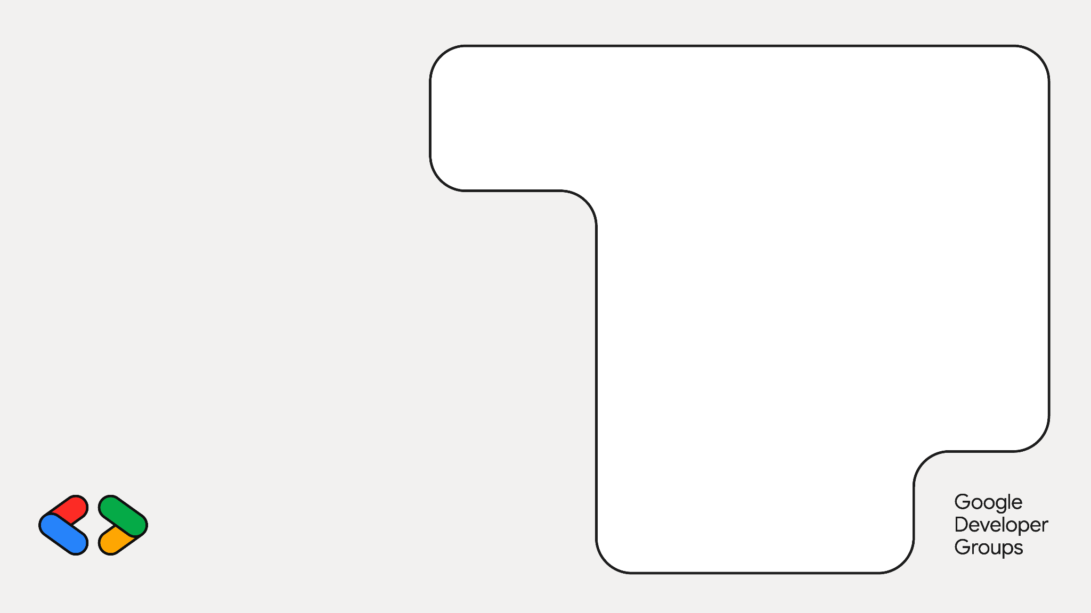
问题？

